Slide 1
Digital Transformation for TCs
2023-06-09
Notes:
This slide deck can be used by TC Secretaries, CCMC Sectoral Project Managers and others to give brief presentations to groups like Technical Committees, Working Groups, Sector Forums, etc. Feel free to use only the slides you find most relevant for your audience.
It is updated from time to time. The latest version is available at:
https://experts.cen.eu/key-initiatives/digital-transformation/
https://experts.cenelec.eu/key-initiatives/digital-transformation/

Slide 2
Strategy 2030
Goal 2: Our customers and stakeholders benefit from state-of-the-art digital solutions
2.1 Produce standards fit for the digital economy
2.2 Transform the standards development process
2.3 Transforming our business models for the digital era
Questions? Email ditsag@cencenelec.eu
Notes:
Digital transformation is a key part of CEN and CENELEC’s Strategy 2030, specifically around “Goal 2” and the 3 “priorities” that support it, as shown here. You can read a lot more about it in the Strategy 2030 document which is published online – just follow the link by clicking on the image or type “cen cenelec strategy 2030” into Google.
The implementation of Goal 2 is managed by DITSAG, who you can contact via ditsag@cencenelec.eu

Slide 3
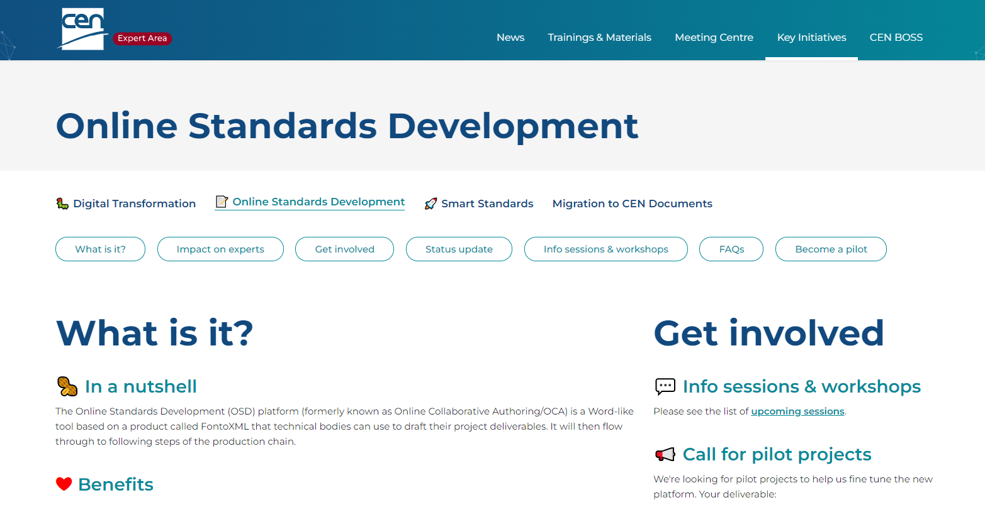
2 key projects
Project 1: Online Standards Development
Project 2: SMART Standards
All info published on the CEN & CENELEC Experts sites under Key Initiatives
https://experts.cen.eu/
https://experts.cenelec.eu/
(no login required)

Slide 4
Online Standards Development (OSD)

Slide 5
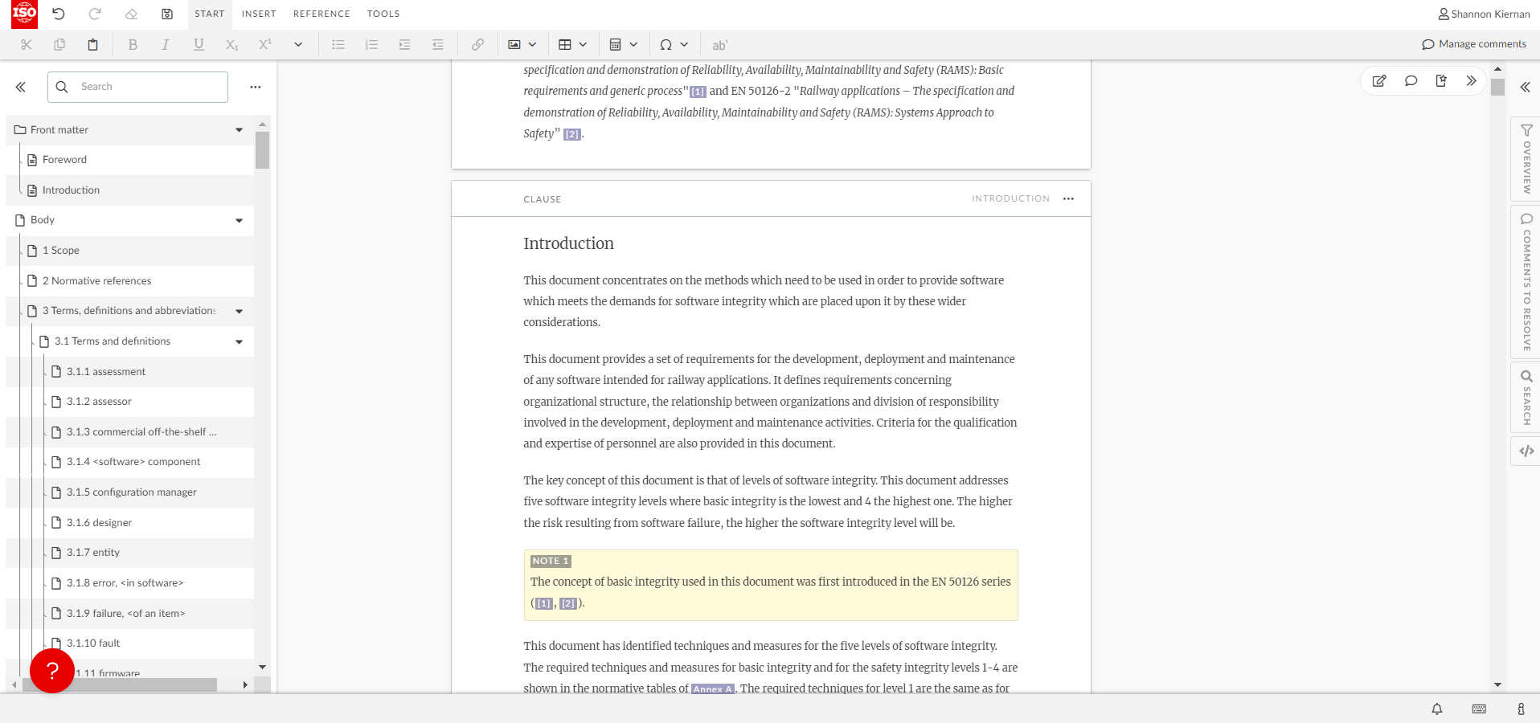
Project 1: Online Standards Development
Questions? Email ebaumard@cencenelec.eu
Expressions of interest via Experts sites (CEN/CENELEC)
Notes:
Goal: Provide a browser-based platform for drafting, commenting & editing CEN & CENELEC deliverables that is well-adapted to the ecosystem.
It provides a lot of advantages like:
Collaborative editing of the same document, with clause lock and unlock features
Normative references lookups
Automatic structuring and numbering
Different access levels for leaders, authors and contributors (commenters)
Quality checks in accordance with the CEN-CENELEC internal regulations (ISO/IEC directives)
We have a lot of CEN pilots already. Their feedback has been very positive and they’ve contributed with great suggestions for improvements that have been incorporated. However, we have had very few CENELEC pilots and are looking for more so we can make sure that CENELEC-specific requirements are incorporated.
The project is led by ISO & IEC and we are making sure that CEN & CENELEC requirements are incorporated.

Slide 6
SMART Standards

Slide 7
Vision
Today
2024
1
2
A
Level 0
Level 1
Level 2
Level 3
Level 4
SMART Programme
Document-centric
Document-centric
Paragraph (clause) - centric
Sentence (provision) - centric
Data - centric
Notes:
Goal: Transform the way standards are developed by making them machine readable and thus meet the needs of standards users’ digitalized industries by Dec 2024
The different pieces of content within the standard will be broken up, tagged with the type of information they hold, and linked with with other pieces of the standard. It allows standards users to do tech savvy things with them, eg: importing them into requirements management systems. But the same content can still be represented in traditional formats like PDF.
At the moment we work in a mixture of Level 1 (PDF/Word) and Level 2 (NISO STS), where the XML tags relate to clause level. By the end of this project, we want to be capable of working at Level 3, where the tags (eg: XML tags) would relate to provision (sentence) level.
We are collaborating with groups undertaking similar initiatives at ISO (ISO SMART) and IEC (SG 12).

Slide 8
Objectives
Structuring and Enriching Standards Content towards Level 3
“[…] CEN-CENELEC will provide Level 3 standards (“Machine Readable Content”, as defined by the SMART Utility Model of IEC SG12 and adopted by CEN-CENELEC and ISO), while ensuring that lower utility levels can also be provided from the same source content. Simply put, this involves breaking up sentences and other content into their constituent pieces and tagging them with what type of information they contain.”
(Definition from SMART standards project charter 2021, shortened)

Slide 9
Level 3 Features
Level 3 content is the NISO STS XML content in Level 2.
Level 3 content is extended and enriched Level 2 content.
Level 3 is embedding granular information units
Level 3 is supporting a first set of functionalities (expressed as Generic User Stories – GUS)
Level 3
Sentence (provision) - centric
Not in scope
of SMART Standards Level 3
Fragmentation of standards content below provision level
Semantic enrichment (RDF, triple structuring, use of ontologies)

Slide 10
Level 3 Features
Relevant Information Units:
Scope statement
Terms and Definitions
Requirements
Properties of materials
Product properties
Parts identifiers
Formulae, equations
Units of measurement (SI)
Graphical content (figures)
All the information presently tagged in CEN-CENELEC standards (ie Level 2)
File attachments
Functionalities:
References (GUS #1)
Notifications (GUS #2)
Search (GUS #3)
Standards matching (GUS #5)
Information unit matching (GUS #6)
Export of Information units (GUS #9)

Slide 11
Project Structure & Status
Workstream (WS) | Example work packages | Status
WS1 - Standards maker engagement | Requirements gathering, training & communications | First Member survey & webinar being planned for 2022-11
WS2 - Standards user engagement | Requirements gathering, marketing | Gathering user stories via national user groups. First batch compiled & cleaned.
WS3 - Technical solutions | Prototypes, storage, creation, use, the information model, integration into the ecosystem and version control | First version of the information model defined. Decided to use Fonto XML as the frontend tool for first pilots. Consolidating requirements.
WS4 – Operationalization | Processes, procedures, support, KPIs and release management | Discussion concerning the possible changes to Internal Regulations are ongoing.
WS5 - Business model | Legal and commercial arrangements, pricing, IPR | Proposed changes to Guide 10 submitted to the Joint Commercial Advisory Group (JCAG). Now working through the set of generic user stories (= high level capabilities expected to be enabled by smart standards) and examining the potential impact on member business models.

Slide 12
How to engage
2) Share expectations and needs
3) Pilot
1) Follow progress
Format use : User stories (same as ISO/IEC SMART Programme)
Collected nationally : Contact available on the CEN & CENELEC webpages
Dedicated CEN and CENELEC webpages:
https://experts.cen.eu/key-initiatives/smart-standards/
https://experts.cenelec.eu/key-initiatives/smart-standards/
Currently under preparation launching expected in Q3 2023
Further information will be available in the coming weeks
Pilot will use an updated version of the OSD tool
Contact : skiernan@cencenelec.eu

